Slide 1


Ruby on Rails vs ASP.NET MVC
Sandro Paganotti Software Architect, Wave Factory
http://sandropaganotti.com/
Twitter: @sandropaganotti
Simone Chiaretta Web Architect, Council of the EU
http://codeclimber.net.nz
Twitter: @simonech
Milano, 19 Febbraio 2011

Slide 2
Join the Conf: the app

Slide 3
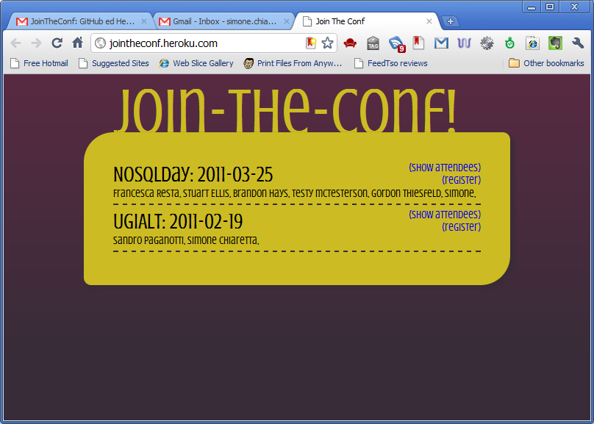
Conference List

Slide 4
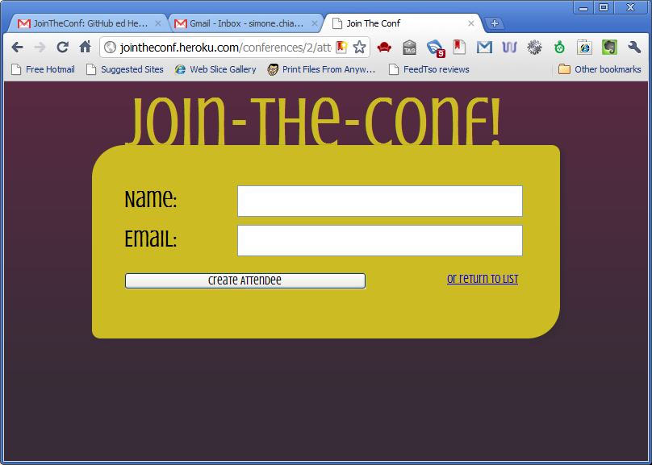
Attendee Registration

Slide 5
Join the Conf: the making

Slide 6
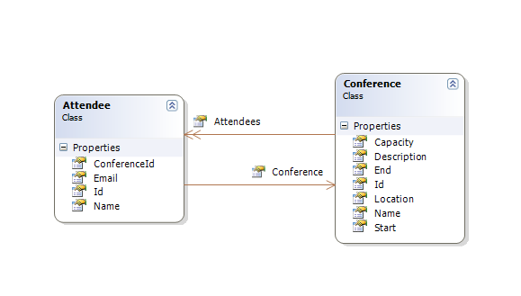
The Model

Slide 7
Project Setup
rails new join_the_conf -d mysql
cd join_the_conf
mate config/database.yml
rake db:create
rails server
[File>New Project>ASP.NET MVC 3 Application]

Slide 8
Install Dependencies
mate Gemfile
gem 'devise'
gem 'rails_admin', :git => '...'
gem 'haml‘
bundle install
Install-Package MvcScaffolding

Slide 9
Create Model
rails generate resource Conference
name:string
description:text
start:date
end:date
location:string
capacity:integer -a index
public class Conference
{
public int Id { get; set; }
public string Name { get; set; }
public string Description { get; set; }
public DateTime Start { get; set; }
public DateTime End { get; set; }
public string Location { get; set; }
public int Capacity { get; set; }
}

Slide 10
Create BackOffice
rails generate rails_admin:install_admin
Administrator
rake db:migrate
rails server
http://localhost:3000/admin
Scaffold Controller Attendee
Scaffold Controller Conference
[Build]
http://localhost:2246/Admin/Conference

Slide 11
Validation
class Attendee < ActiveRecord::Base
belongs_to :conference
validates_presence_of :conference_id,
:name, :email
validates_uniqueness_of :email,
:scope => :conference_id
end
public class Attendee
{
public int Id { get; set; }
public int ConferenceId { get; set; }
[Required] public string Name { get; set; }
[Required] public string Email { get; set; }
virtual public Conference Conference { get; set; }
}

Slide 12
Routing
resources "conferences",
:only => [:index] do
resources "attendees",
:only => [:index, :create]
End
rake routes
public class ConferencesController : Controller
public ViewResult Index()
public class AttendeesController : Controller
public ViewResult Index()
public ActionResult Create(Attendee attendee)

Slide 13
Controller
class ConferencesController ...
def index
@conferences = Conference.all(
:order=>'start DESC')
end
end
public class AttendeesController : Controller
{
private JTCContext context = new JTCContext();
public ViewResult Index()
{
return View(context.Attendees.ToList());
}
}

Slide 14
Layout
!!! 5
%html
%head
%title Join The Conf
= stylesheet_link_tag :all
= javascript_include_tag :defaults
= csrf_meta_tag
%body= yield
<!DOCTYPE html>
<html>
<head>
<titleJoin The Conf</title>
<link href="@Url.Content("~/Content/frontend.css")" rel="stylesheet" type="text/css" />
<script src="@Url.Content("~/Scripts/jquery-1.4.4.min.js")" type="text/javascript"></script>
</head>
<body>
<h1>Join The Conf</h1>
@RenderBody()
</body>
</html>

Slide 15
Views
conferences/index.html.haml
%ul= render @conferences
conferences/index.cshtml
<ul>
@foreach (Conference item in ViewBag.Conferences)
{
@Html.Partial("_conference", item)
}
</ul>

Slide 16
Partial Views
conferences/_conference.html.haml
%li = "#{conference.name} - #{conference.start}"
= link_to '(show attendees)',
conference_attendees_path(conference)
conferences/_conference.cshtml
<li>
@Model.Name: - @Model.Start @Html.ActionLink("(Register)","New","Attendees")
</li>

